Slide 1
EMS Interoperability Task Force November 9, 2023
Patient Identification and Record Matching
Notes:
This meeting is being recorded and will be posted. If you need anything removed from the recording, let us know.
Note change to moderated format, use hand raise feature to be acknowledged to speak.
Amit no longer with HIMSS. Introduce Christina Caraballo, IHE USA President and HIMSS VP of Informatics.
Introduce Trent Gavazzi and team at CareEvolution.
Any other new participants?

Slide 2
Task Force Overview
Monthly, 2nd Thursday, 11a–12:30p MT
Nov 9, Dec 14 Dec 15 (EMS Data Summit), Jan 11, Feb 8, Mar 14, Apr 11, May 9, Jun 13
Topics:
Feb 16: Identifying data exchange partners and establishing relationships
Mar 9: Governmental, regulatory, and contractual environment
Apr 13: Regulatory environment and national networks recap
May 11: Sequence/workflow: SAFR design
Jun 8: Sequence/workflow
Jul 13: Standards and profiles overview
Specific standards and profiles to use in workflow:
Aug 10: EMS to Hospital
Sep 14: Hospital Outcomes to EMS
Oct 12: Patient History to EMS
Nov 9: Patient identification and record matching
Data elements to be shared and parsed
APIs
Notes:
Reminder of task force purpose: to help EMS software vendors develop interoperability solutions for their customers
We’ve scheduled 2024 meetings through June, will use as needed

Slide 3


ONC Annual Meeting & EMS Data Summit
ONC Annual Meeting
EMS Data Summit
December 14–15, 2023
Washington DC
ONCannualmeeting.com
December 15, 12:30–3:30p ET
Washington DC and online
umarket.utah.edu/um2/nemsis
Notes:
Note start time change (to give people time to get lunch in DC)
https://www.oncannualmeeting.com/
https://umarket.utah.edu/um2/nemsis/

Slide 4
EMS Data Summit
Opportunities for EMS and Healthcare Interoperability: Overview on TEFCA and USCDI/USCDI+
Interoperability from the EMS Agency Perspective: Benefits of Interoperability
Interoperability Current Status and Next Steps from the Network Perspective
Panel: Addressing EMS Interoperability Opportunities
Notes:
Policy perspective

Slide 5
HIMSS24 Interop Showcase and IHE Connectathon
Phil DePalo

Slide 6
ONC Letter
Will be sent from NHTSA to ONC
EMS is entry point into healthcare system
EMS does not routinely have data interoperability today
Interop touchpoints: patient history to EMS, EMS report to hospital, hospital outcomes to EMS
Future delivery models, including home-based care by EMS, require interoperability
Specialty system hospitals are required to share data with EMS
NEMSIS is nationwide standard for EMS
EMS is ready to adopt existing standards and networks to interoperate
Need for EMS representation in federal health IT, including TEFCA
Need for timely data due to nature of EMS
Need for responses to “healthcare operations” queries to get outcomes

Slide 7
Today’s Topic
Standards and profiles to use in the patient identification stage of the interoperability workflow

Slide 8
Today’s Questions
What standards and profiles are used for the Patient Discovery phase of the interoperability workflow?
How do master patient indexes work, and how can EMS use them?
How will patient identification work most of the time on EMS calls?
How will patient identification work on EMS calls where there isn’t enough information about the patient?

Slide 9
Discussion
Review profiles in sequence diagram
Lee Prosch, ESO: Enterprise Master Patient Index
CareEvolution: Patient identification considerations

Slide 10
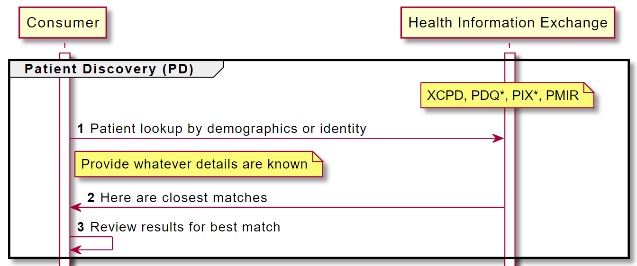

Slide 11
XCPD: Cross-Community Patient Discovery
An IHE Profile
Supports the means to locate communities which hold patient relevant health data and the translation of patient identifiers across communities holding the same patient’s data.
profiles.ihe.net/ITI/TF/Volume1/ch-27.html

Slide 12
PDQ: Patient Discovery Query
An IHE Profile
Provides ways for multiple distributed applications to query a patient information server for a list of patients, based on user-defined search criteria, and retrieve a patient’s demographic (and, optionally, visit or visit-related) information.
profiles.ihe.net/ITI/TF/Volume1/ch-8.html

Slide 13
PIX: Patient Identifier Cross-referencing
An IHE Profile
Supports the cross-referencing of patient identifiers from multiple Patient Identifier Domains
profiles.ihe.net/ITI/TF/Volume1/ch-5.html

Slide 14
PMIR: Patient Master Identity Registry
An IHE profile
Supports the creating, updating and deprecating of patient master identity information about a subject of care, as well as subscribing to changes to the patient master identity, using the HL7 FHIR standard resources and RESTful transactions.
profiles.ihe.net/ITI/PMIR/index.html

Slide 15
Enterprise Master Patient Index (EMPI)
Lee Prosch, ESO

Slide 16
Patient Identification Considerations
CareEvolution team

Slide 17

Did We Answer Today’s Question?
What standards and profiles are used for the Patient Discovery phase of the interoperability workflow?
How do master patient indexes work, and how can EMS use them?
How will patient identification work most of the time on EMS calls?
How will patient identification work on EMS calls where there isn’t enough information about the patient?
Notes:
Give link to survey in chat:
https://forms.office.com/r/Z1ER9MqctE

Slide 18
Next Steps
Survey for today’s task force call
Task Force Email Group
groups.google.com/g/ems-task-force
Github Repository and Wiki (includes link to sequence diagram)
github.com/IHE/EMS
December: ONC Annual Meeting and EMS Data Summit
Next Task Force topic: what’s the important information needed by EMS and hospital staff?
Notes:
For the next few task force calls, we need EMS and hospital provider perspectives to help us identify the information they need in the interoperability workflow.

